Slide 1

Title: Procurement in Project Management
Subtitle: Understanding the Essentials
Group 6

Slide 2

Introduction to Procurement
Procurement is the process of obtaining goods and services from external sources. In the context of project management, procurement plays a crucial role in ensuring project success by acquiring the necessary resources and expertise.

Slide 3

Procurement Process Overview
The procurement process involves several stages, including planning, solicitation, source selection, contract administration, and contract closeout. Each stage is essential for effectively managing procurement activities within a project

Slide 4


Procurement Planning
Procurement planning is the initial phase where project needs and requirements are identified. This phase also involves determining the procurement methods and strategies to be employed, aligning them with project goals and objectives.

Slide 5

Types of Procurement
There are different types of procurement contracts, including Fixed Price, Cost Reimbursement, and Time and Material Contracts.
1. Fixed Price Contracts: Set price, regardless of actual costs.
2. Cost Reimbursement Contracts the contractor is paid for expenses and receives an additional fee.
3. Time and Material Contracts: Payment based on time and materials used.

Slide 6

Procurement Documents
Essential procurement documents include Request for Proposal (RFP), Invitation for Bid (IFB), and the final contract. These documents provide detailed information about project requirements, specifications, and terms and conditions.

Slide 7

Selecting the right vendors is crucial for project success. Criteria for vendor selection may include cost, quality, experience, reputation, and compliance with project requirements.
Vendor Selection Criteria

Slide 8

Solicitation
During the solicitation phase, RFPs or IFBs are issued to potential vendors. This phase involves receiving and evaluating bids or proposals submitted by vendors.
The Sun’s mass compared to Earth’s
Distance between Earth and the Moon

Slide 9

Source selection involves evaluating bids or proposals and selecting the vendor who best meets the project requirements. Factors such as cost, quality, and vendor capabilities are considered during this phase.
Source Selection

Slide 10
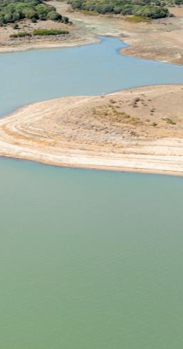
Contract Administration
Contract administration is essential for ensuring compliance with contract terms and conditions. It involves managing vendor performance, addressing any issues or disputes that may arise, and ensuring the successful completion of the contract.

Slide 11

Risk Management in Procurement
Identifying and managing procurement risks is critical for project success. Strategies for mitigating procurement risks include conducting thorough risk assessments, implementing risk mitigation measures, and monitoring risk throughout the procurement process.

Slide 12
RESOURCES
Procurement Ethics
Ethics play a significant role in procurement. Ensuring fairness, transparency, and integrity in the procurement process is essential for building trust and maintaining good relationships with vendors and stakeholders.

Slide 13
Procurement Performance Measurement
Measuring procurement performance helps evaluate the effectiveness of procurement activities and identify areas for improvement. Key metrics may include cost savings, vendor performance ratings, and contract compliance.

Slide 14
Procurement is important for project managers because it helps them manage resources well and keeps everything running smoothly. It ensures that everyone involved in a project talks to each other and works together. By planning ahead and ordering things early, they can avoid problems later on. This saves time and money and makes sure the project stays on track.
Benefits of procurement

Slide 15
Conclusion
In conclusion, effective procurement is essential for project success. By understanding the procurement process and implementing best practices, project managers can ensure the timely acquisition of resources and the successful completion of project objectives.

